Slide 1

Annual
Transportation Registration

Slide 2
Why?
Gathering this data each year will give Transportation a better idea of how many students will actually be riding the bus.

Slide 3
Process for Existing Families
Parent/Guardian will login to their parent portal.
Click on “More”
Click on “Transportation Request”
Select “English” or “Spanish”
Read through the information and click to proceed to the application
Select “yes” or “no” on any/all students who are eligible to receive bussing
Click “Submit”
*Explanation will be provided on the page if a student is not eligible*
*Registration for the 2023-24 school year will go live June 5, 2023.

Slide 4
Process for New Families
The transportation question will be added to the OLR (online registration) application for new families registering their student(s) for the first time with CUSD.
Registration for the 2023-24 school year will go live June 5, 2023.

Slide 5
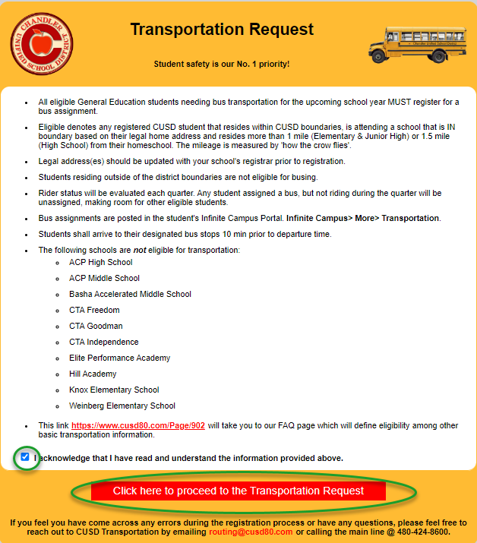
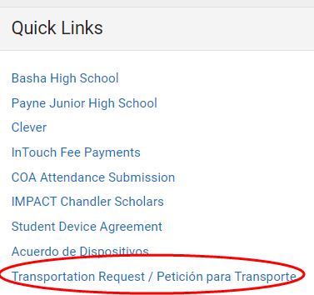
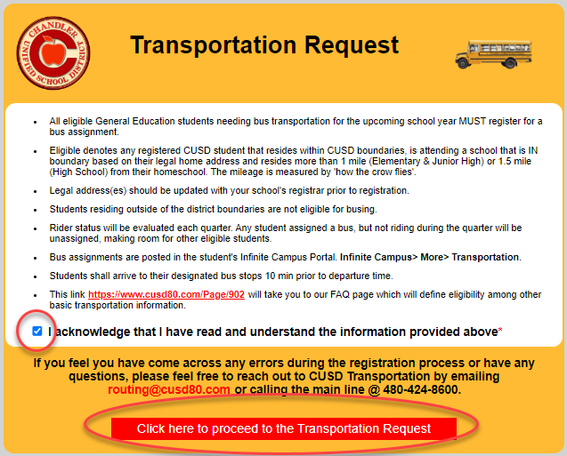
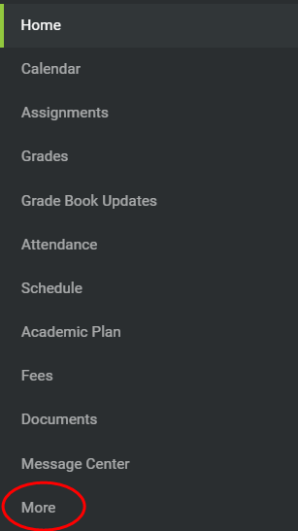
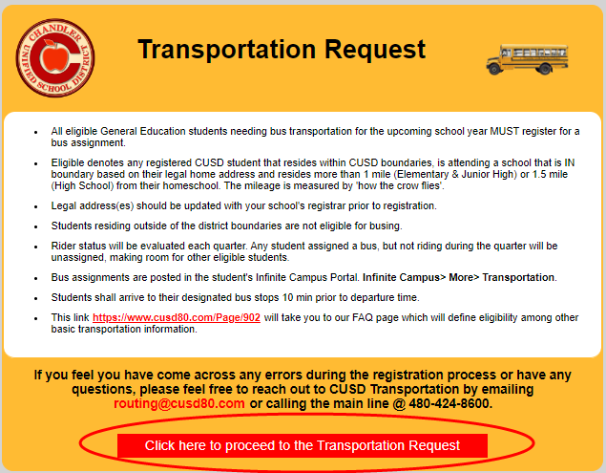
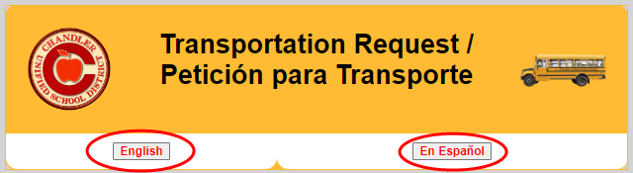
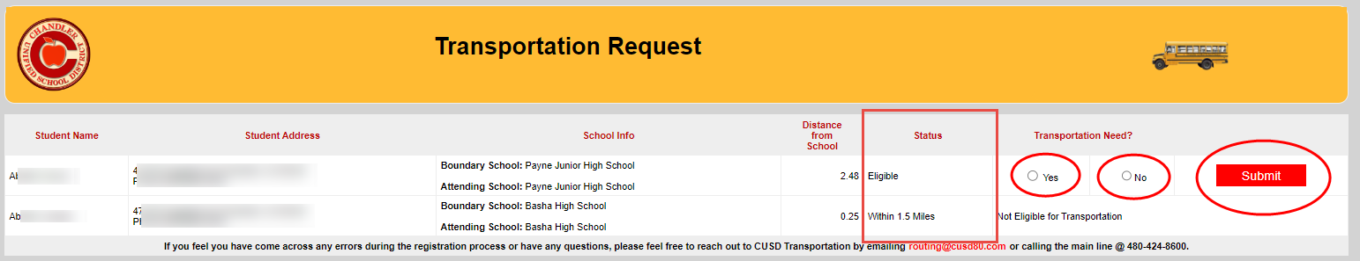
Screenshots after logging into Parent Portal
Once submitted, you will not be able to change your answer. If you want to change your selection, you’ll need to contact the Transportation department at routing@cusd80.com or 480-424-8600.

Slide 6
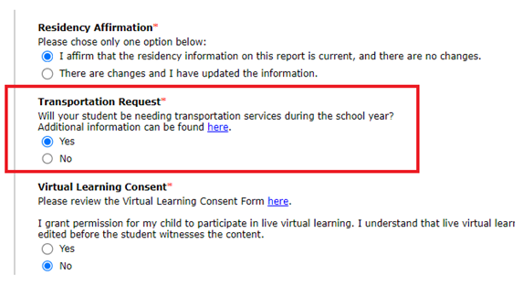
New Families – OLR Application

Slide 7
Exclusions
The following sites will automatically be excluded from this process as they are either walking boundaries only or Open Enrollment:
ACP High School
ACP Middle School
CTA Goodman
CTA Freedom
CTA Independence
Hill Learning Academy
Knox Gifted Academy
Weinberg
Elite Performance Academy
Basha Accelerated Middle School

Slide 8
Questions?
Sites and Parents will contact Transportation with any specific questions regarding bussing.
routing@cusd80.com or
480-424-8600

Slide 9
How do I find out what the student’s bus details are? Will parent’s be sent letters?
No more letters (except for ACP families)
Every student’s transportation details will appear in their Infinite Campus account 3-7 business days after registration is completed.

